Slide 1

Az National Trucking Data Analysis
BUAN 6346.001 - Big Data - F23
GROUP 4:
Elias Rodriguez – EXR131030
Ravipalli Sai Sugun– RXS220117
Uzma Batool Shah – UBS220000
Muaz Ali Syed –MXS220139
Ashritha Thanga – AXT220073
Sneha Thunga- SXT220053

Slide 2
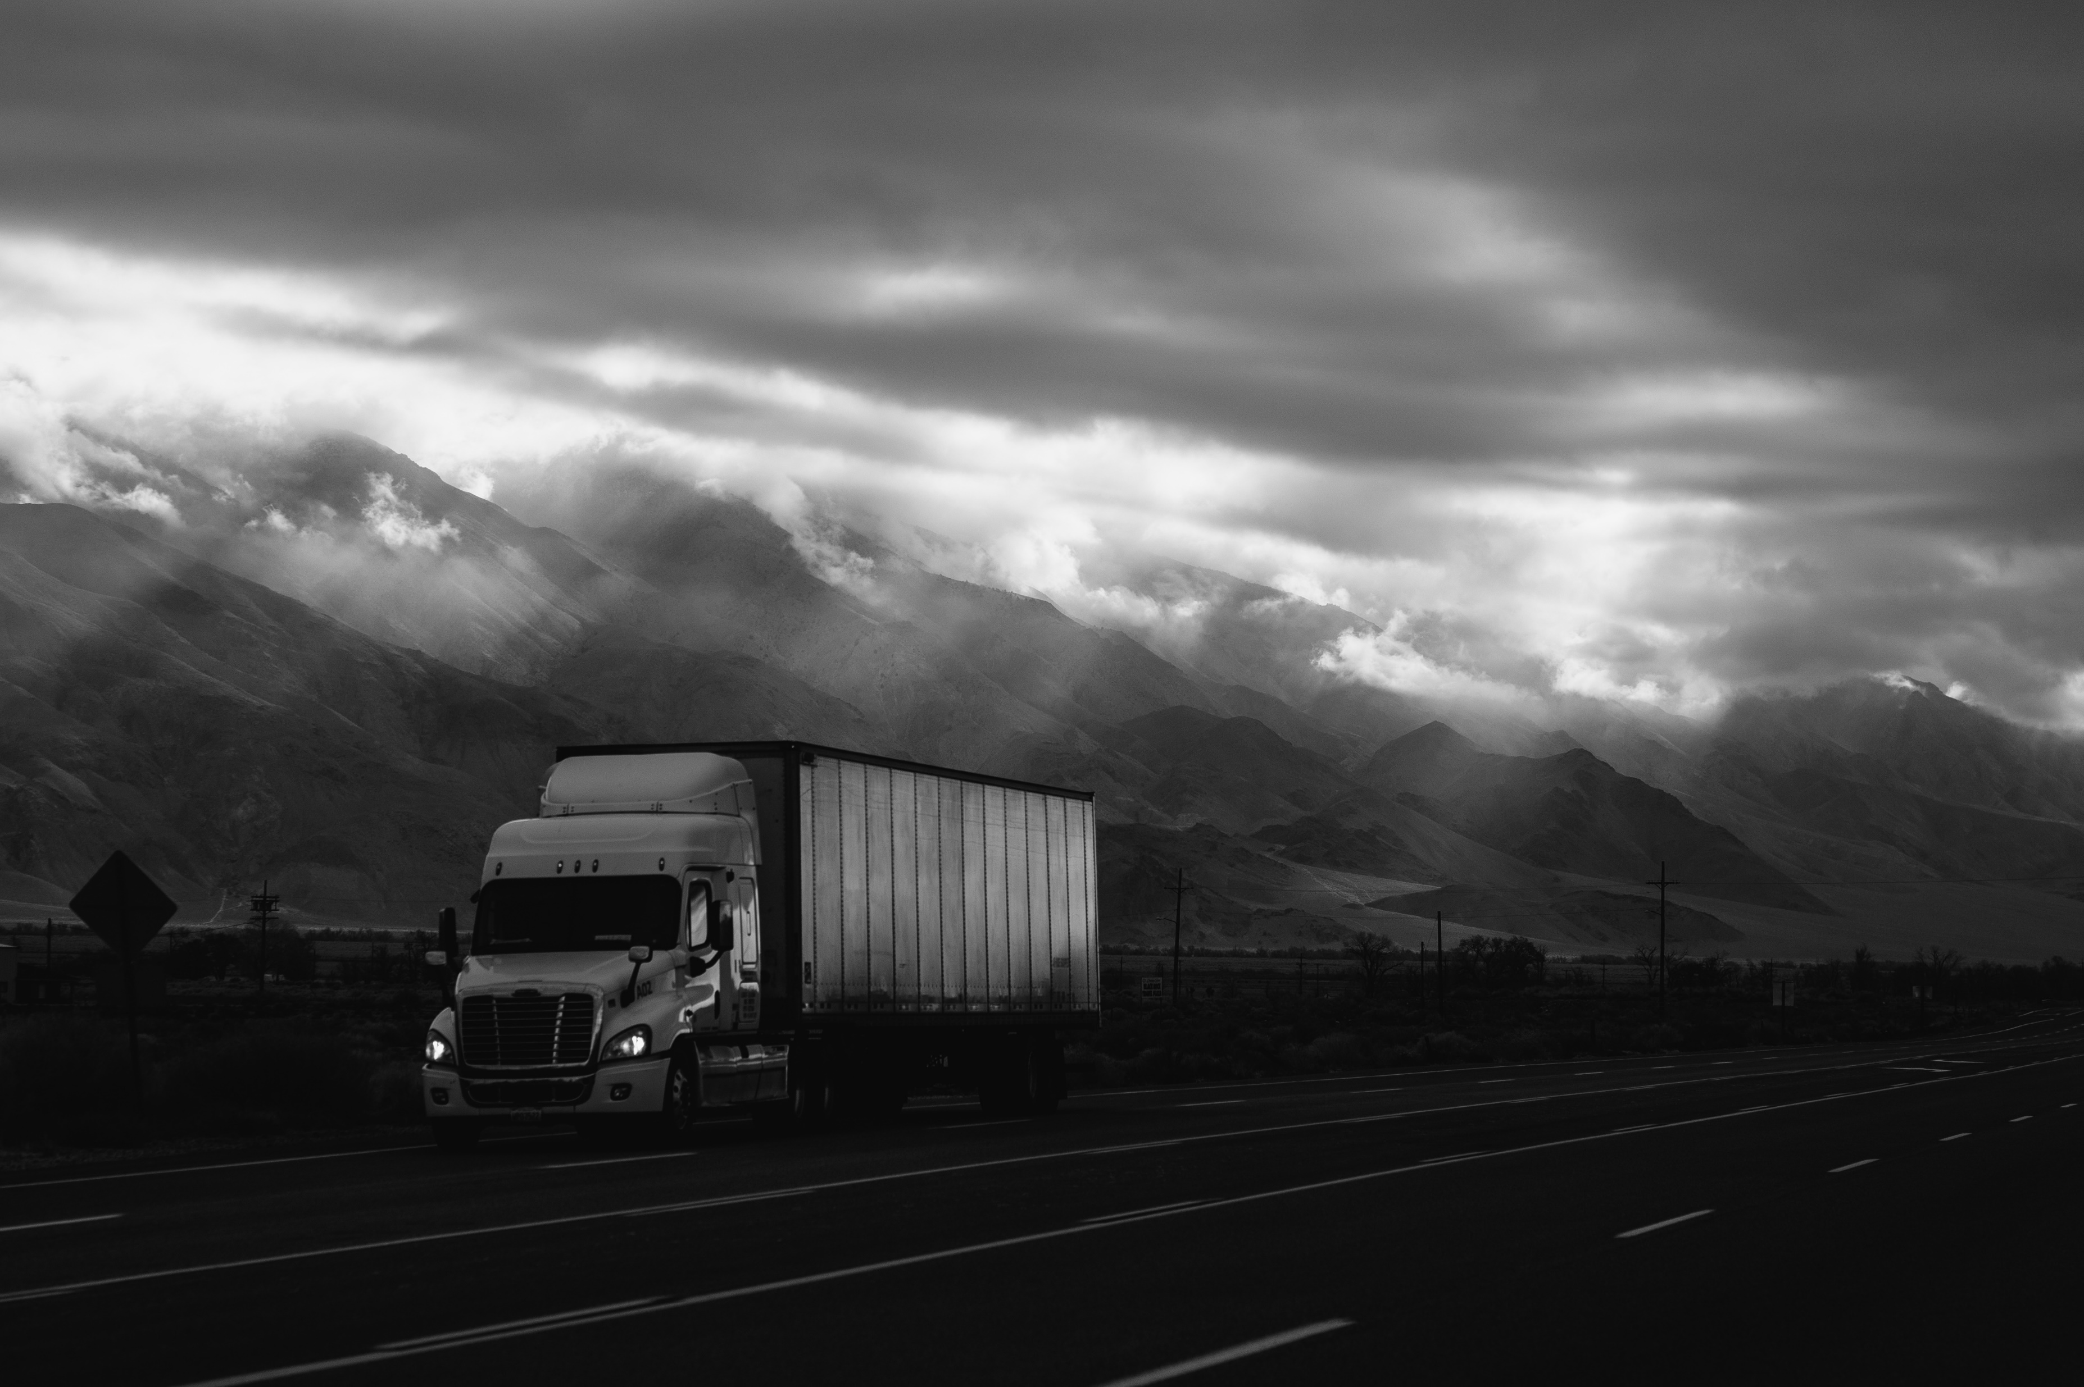
Problem Statement
ANT is a 10-year-old organization. It has a total 400 employees, and its primary business is long distance trucking services, and they specialize in general and non-specialized cargo types.
The high frequency of injuries and fatalities resulting from accidents involving large trucks in the United States necessitates the need to ensure that all drivers in the fleet comply with the corporation's regulations and do not pose an insurance risk due to various factors, presenting a significant challenge for fleet managers.
Objective
The aim is to reduce the number of accidents caused by large commercial trucks and ultimately minimize the injuries and deaths resulting from these accidents in California, by analysing each driver's data and implementing measures to mitigate the risks associated with them.
Eventually, assess and anticipate risk factors related to drivers based on several factors such as events, total distance travelled, average speed, and mileage.

Slide 3






Data Workflow
Using ODBC driver importing tables in Tableau
Download and save the csv files on local system
Move the files to VMware
Moving files from local directory to HDFS
Import data in Impala
Creating the riskfactor table and populating the table using PIG

Slide 4
Data Lineage
trucks_mg
avg_mileage
Trucks
Truck_mileage
driver_mileage
Geolocation
Important Columns For Modelling:
Driver_Average_mileage
Total Miles
Number of Events
Speed
Risk Factor
Riskfactor : populated using Pig latin script

Slide 5
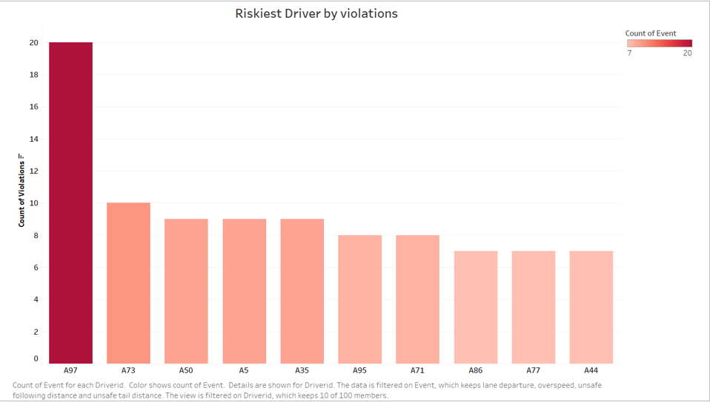
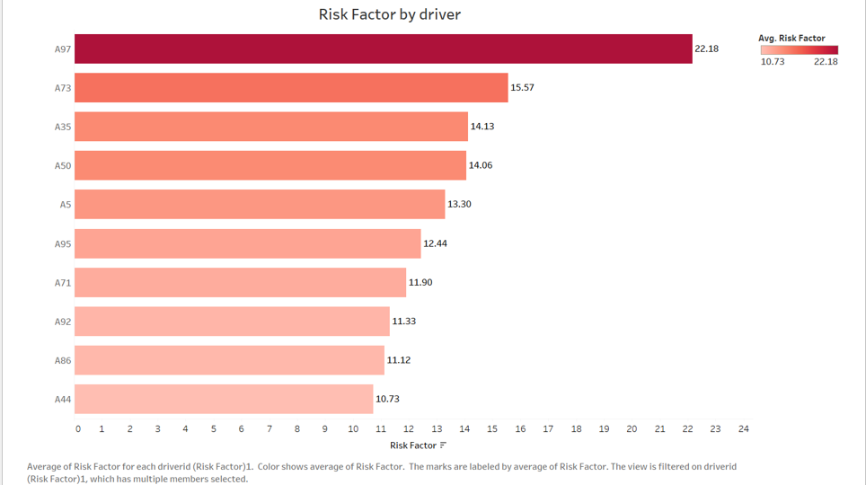
Analysis 1 and 2
Analysis:
We found that A97 is the riskiest driver.
Insights:
The highlighted bars represent the most risky drivers (in descending order)
Recommendation:
The most risky drivers should be contacted and their behaviour and driving conditions should be monitored.
Analysis:
We get the risky drivers they are involved in to get the respective risk factors associated with them.
Insights:
The colors represent the different events and the longer the bar, the more is the count of events for a respective driver.

Slide 6
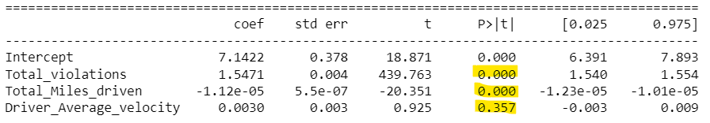
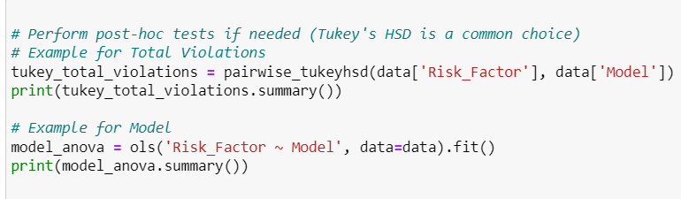
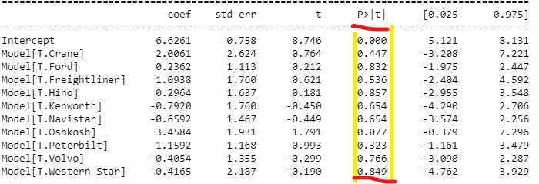
Checking Statistical Significance

Slide 7
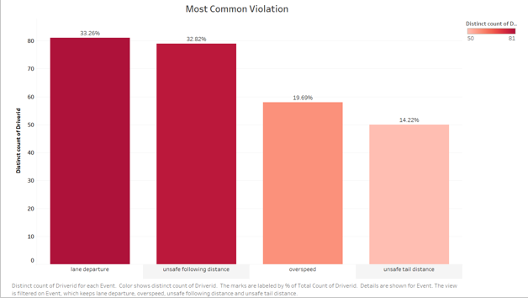
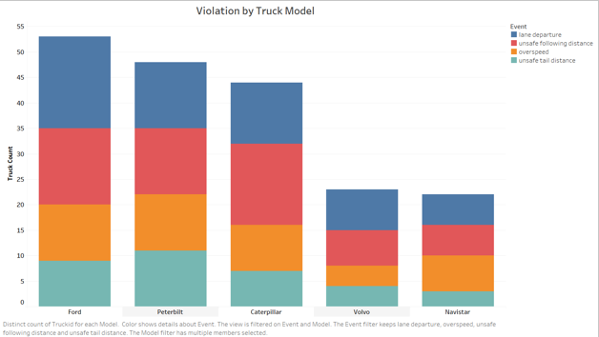
Analysis 3 and 4
Analysis and Insights:
We get the most common violation taking average count of driverids with the events they are involved in.
Analysis and Insights:
We observe that the maximum count of events is associated by model Ford

Slide 8
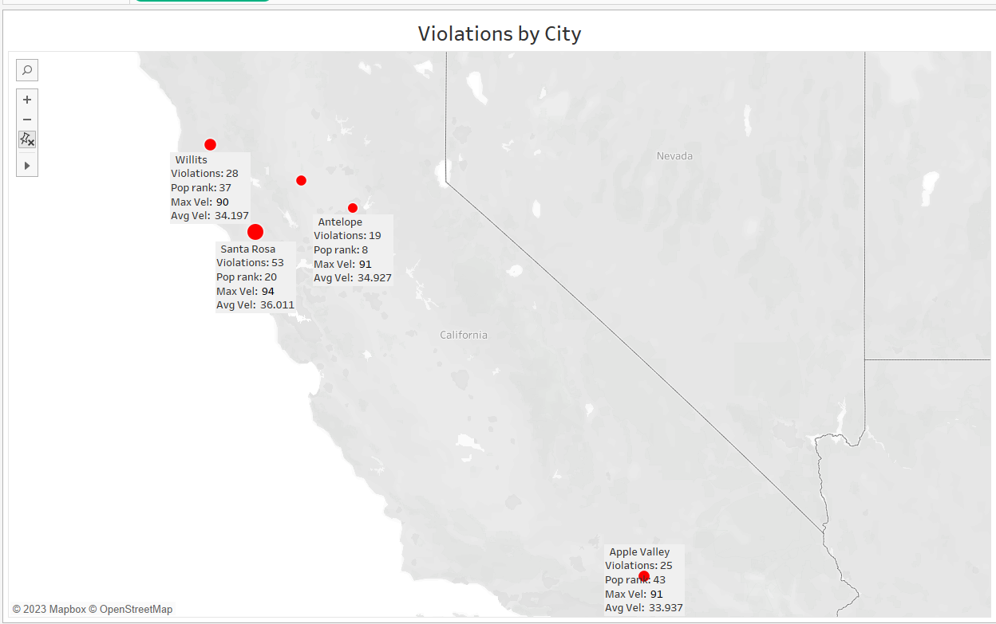
Analysis 5
Analysis:
The distribution is depicted here according to city and geographic location.
The bubble size indicates the number of events happening.
Recommendation:
Specific strategies for each city should be developed depending upon the number of events taking place.

Slide 9
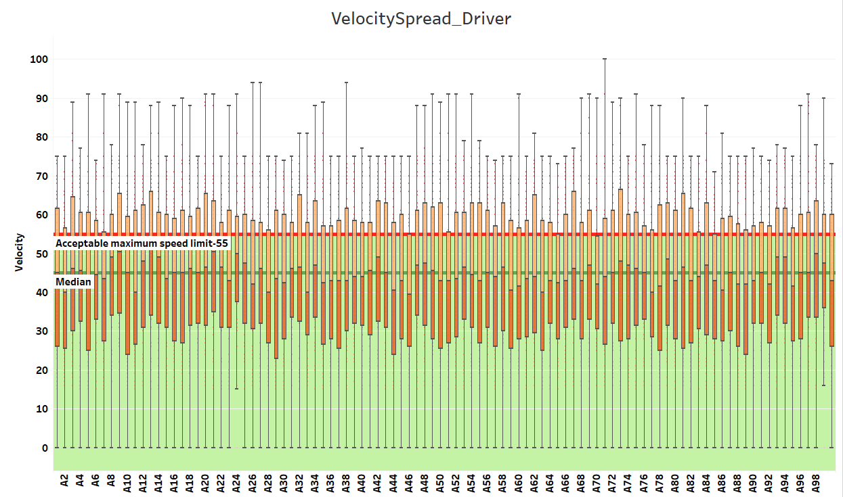
Analysis 6
Data Source:
Geolocation.csv
Analysis:
With a maximum speed limit restriction of 55 mph, almost 80% of the drivers crossed the limit.
Recommendation:
Promote safety, discipline, compliance, and responsible driving culture among California drivers.

Slide 10
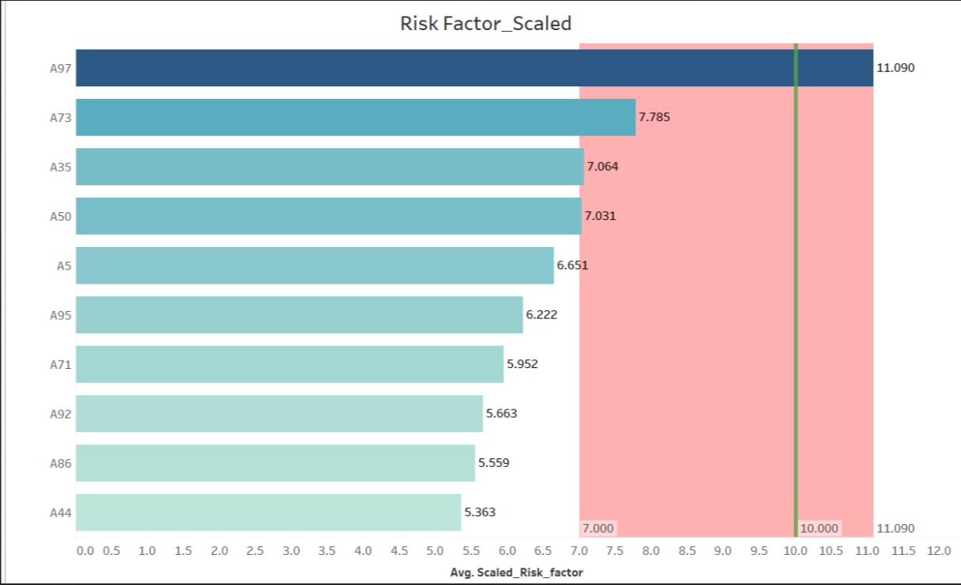
Analysis 7
We Scaled the risk factor of drivers on the rate of 10.
We wanted to highlight A97 risk factor is far higher than any other.
It turned out A73,A35, A50 falls under the risky drivers when we set the threshold as 7.
Recommendations:
The people > 7 this threshold can be
Enforce Disciplinary Measures
training, coaching
The people near this threshold can be:
Training and Education Programs
Incentive Programs
Regular Performance Reviews and Counselling

Slide 11
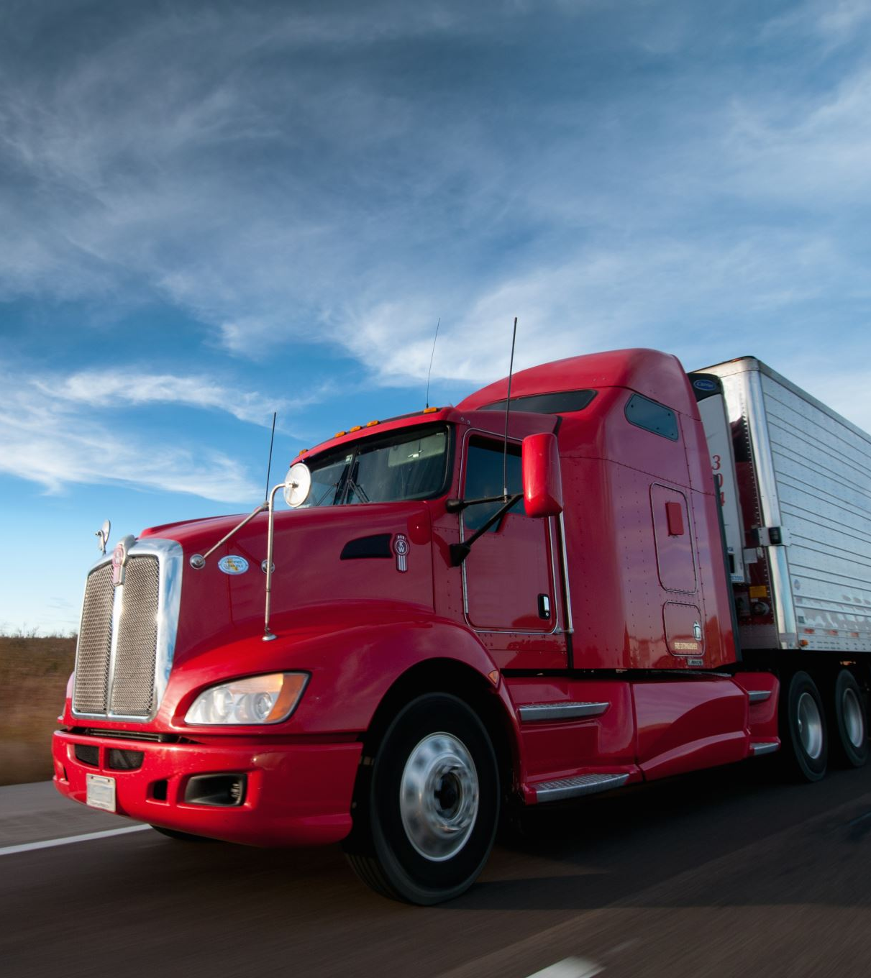
Conclusion and Recommendations for ANT
Truck drivers in Northern California ought to obtain specific training. The most dangerous drivers ought to be monitored, given regular training, and given incentives for finishing tasks.
Each unsafe driver should be paired with an experienced driver during the training phase.
This arrangement is known as a buddy program. Based on the observed insights, the training program must be adjusted.
Truck drivers in accident-prone areas need to be watched after by a specific team at ANT. Drivers with a history of severe accidents shouldn't be given longer trips.
To make good revenues, the ANT company must invest in trucks with higher mileage and less maintenance.

Slide 12

Extra Information
Top 10 risky drivers have least idling time.
Heat map got collinearity
Anova test against risk factor.
Take median velocities of top 5 cities with most incidents(events) and compare it to state’s legal speed.

